Slide 1
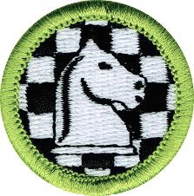
Chess

Slide 5
en Passant

Slide 7
Chess notation
Row Up - File Across

Slide 8
Openings
Development
Control The Center
Castling
Pawn Structure

Slide 9
Control The Center

Slide 10
Castling

Slide 11
Pawn Structure
Bad
Pawn
Chain
Strong

Slide 12
Fools Mate

Slide 13
Scholar’s Mate (4 move)

Slide 14
Middle Game Strategy
“In the opening a master should play like a book, in the mid-game he should play like a magician, in the ending he should play like a machine.”
-Chess Grandmaster Rudolf Spielmann

Slide 15
Middle Game Strategy
Exploiting a weakness - Unprotected/Overloaded
Force - If you have it start trading
King Safety - Castled behind wall of pawns
Pawn Structure - Chains, Control, Force his hand
Space - How much do you control. Makes attacks easier when your protection is there.
Note: Trade knights if there are less pawns in play as you move toward end game, otherwise trade bishops.

Slide 16
Consider Each Move
Does or will my his last move pose a threat (If it does, respond to it)
Did he meet my last threat?
Is my king safe? Can I attack his King?
Are my pieces protected?
Is one of his pieces left undefended and ready to be captured without risk (is it a trap)?
Do I still have pieces I need to develop?
Can I move a rook into an open D or E file?
Does my opponent have a weakness I can use? Make a plan.
Does the move I am going to make overlook something.

Slide 17
Chess Tactics - Fork
Placing a piece so
your opponent has
to decide between
loosing two pieces

Slide 18
Chess Tactics - Decoy
Sacrifice a piece to
draw another more
valuable one into
a poisoned square

Slide 19
Chess Tactics - Discovered Attack
Moving one piece
reveals a threat from
another

Slide 20
Chess Tactics - Interposing
Don’t run away, fight back!

Slide 21
Chess Tactics - Pin
Force a piece to
stay in place. Take
it out of play.

Slide 22
End Game Strategy
Be careful! The board may look simpler, but mistakes are still easy to make.
Use your king - Best to be away from the sides and fighting.
Control queening squares
Use all your pieces
Every pawn counts - Each one can become a queen
If you are ahead swap non-pawns. If not swap pawns.

Slide 23
Queen+King Checkmate
Catch king against side or corner

Slide 24
Two Rook Checkmate

Slide 25
One Rook Checkmate

Slide 26
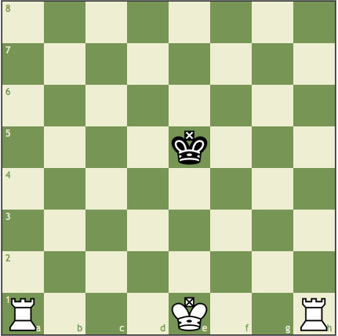
Checkmate Practice

Slide 27
Draws and Stalemates
Stalemate - Not in check, but no legal move.
Insufficient material - Can’t win with just a bishop or just a knight.
50 move rule - No capture or pawn move for 50 moves
Triple-occurrence rule - Same board position 3 times

Slide 28
Direct Mate Problems
1. Black’s Move
2. White’s Move

Slide 29
Direct Mate Problems
3. Black’s Move
4. Black’s Move

Slide 30
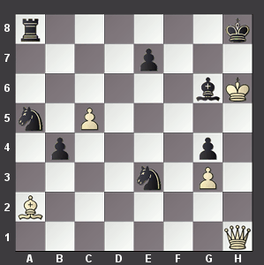
Direct Mate Problems
5. ???? Move

